Slide 1
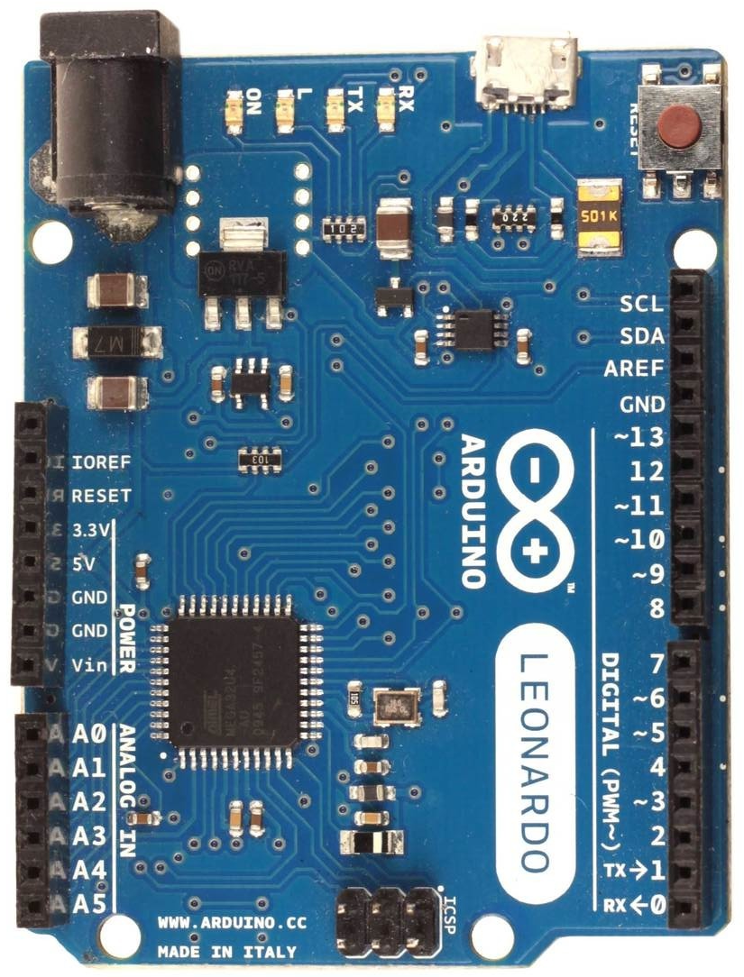
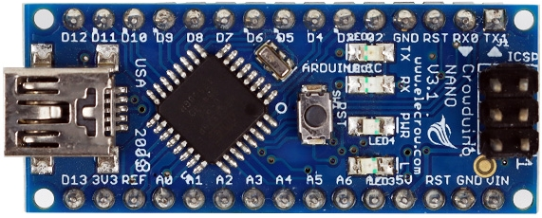
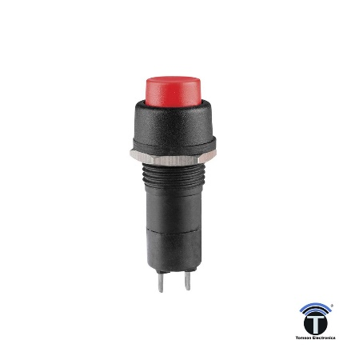
This pinout is valid for firmware fw-vXX1 or fw-vXX2 only
Arduino Leonardo (as wheelbase) -> Arduino Nano or UNO (as button box)
Leonardo GND -> Nano GND
Leonardo 5V -> Nano 5V
Leonardo pin 6 (DT_sh) -> Nano pin 12
Leonardo pin 7 (CLK_sh) -> Nano pin 13
Leonardo pin 8 (PL_sh) -> Nano pin 10 and pin 2
Nano pins available for buttons (16 max):
A0, A1, A2, A3, A4, A5, TX1, RX0, 3, 4, 5, 6, 7, 8, 9, 11
separate button box
*.ino file is provided
one pin of each switch go to one of these pins,
other end of all switches go to GND
when pressed, switch has to short these 2 pins (normally open contact)
Goes in the wheel rim along with all switches
Up to 16 switches are possible (can be less or none)
you will need to find a way to take
5 wires through or around the wheel shaft

